Slide 1
Intro to protobi Quick-start tutorial
Pieter Sheth-Voss, PhD
October 25, 2016
support@protobi.com

Slide 2
How are you doing? No, really!
Gender and Generations Survey by Pew Research Center. Conducted Nov-Dec 2012 | File Release Date: 2014 January 7

Slide 3
How are you doing? No, really!
Every question appears as an interactive chart
Gender and Generations Survey by Pew Research Center. Conducted Nov-Dec 2012 | File Release Date: 2014 January 7

Slide 4
Are healthier people happier?
Click anywhere to filter responses everywhere
Solid colors show the current subset
Thin outlines show the baseline
Triangles show significant differences
Gender and Generations Survey by Pew Research Center. Conducted Nov-Dec 2012 | File Release Date: 2014 January 7

Slide 5
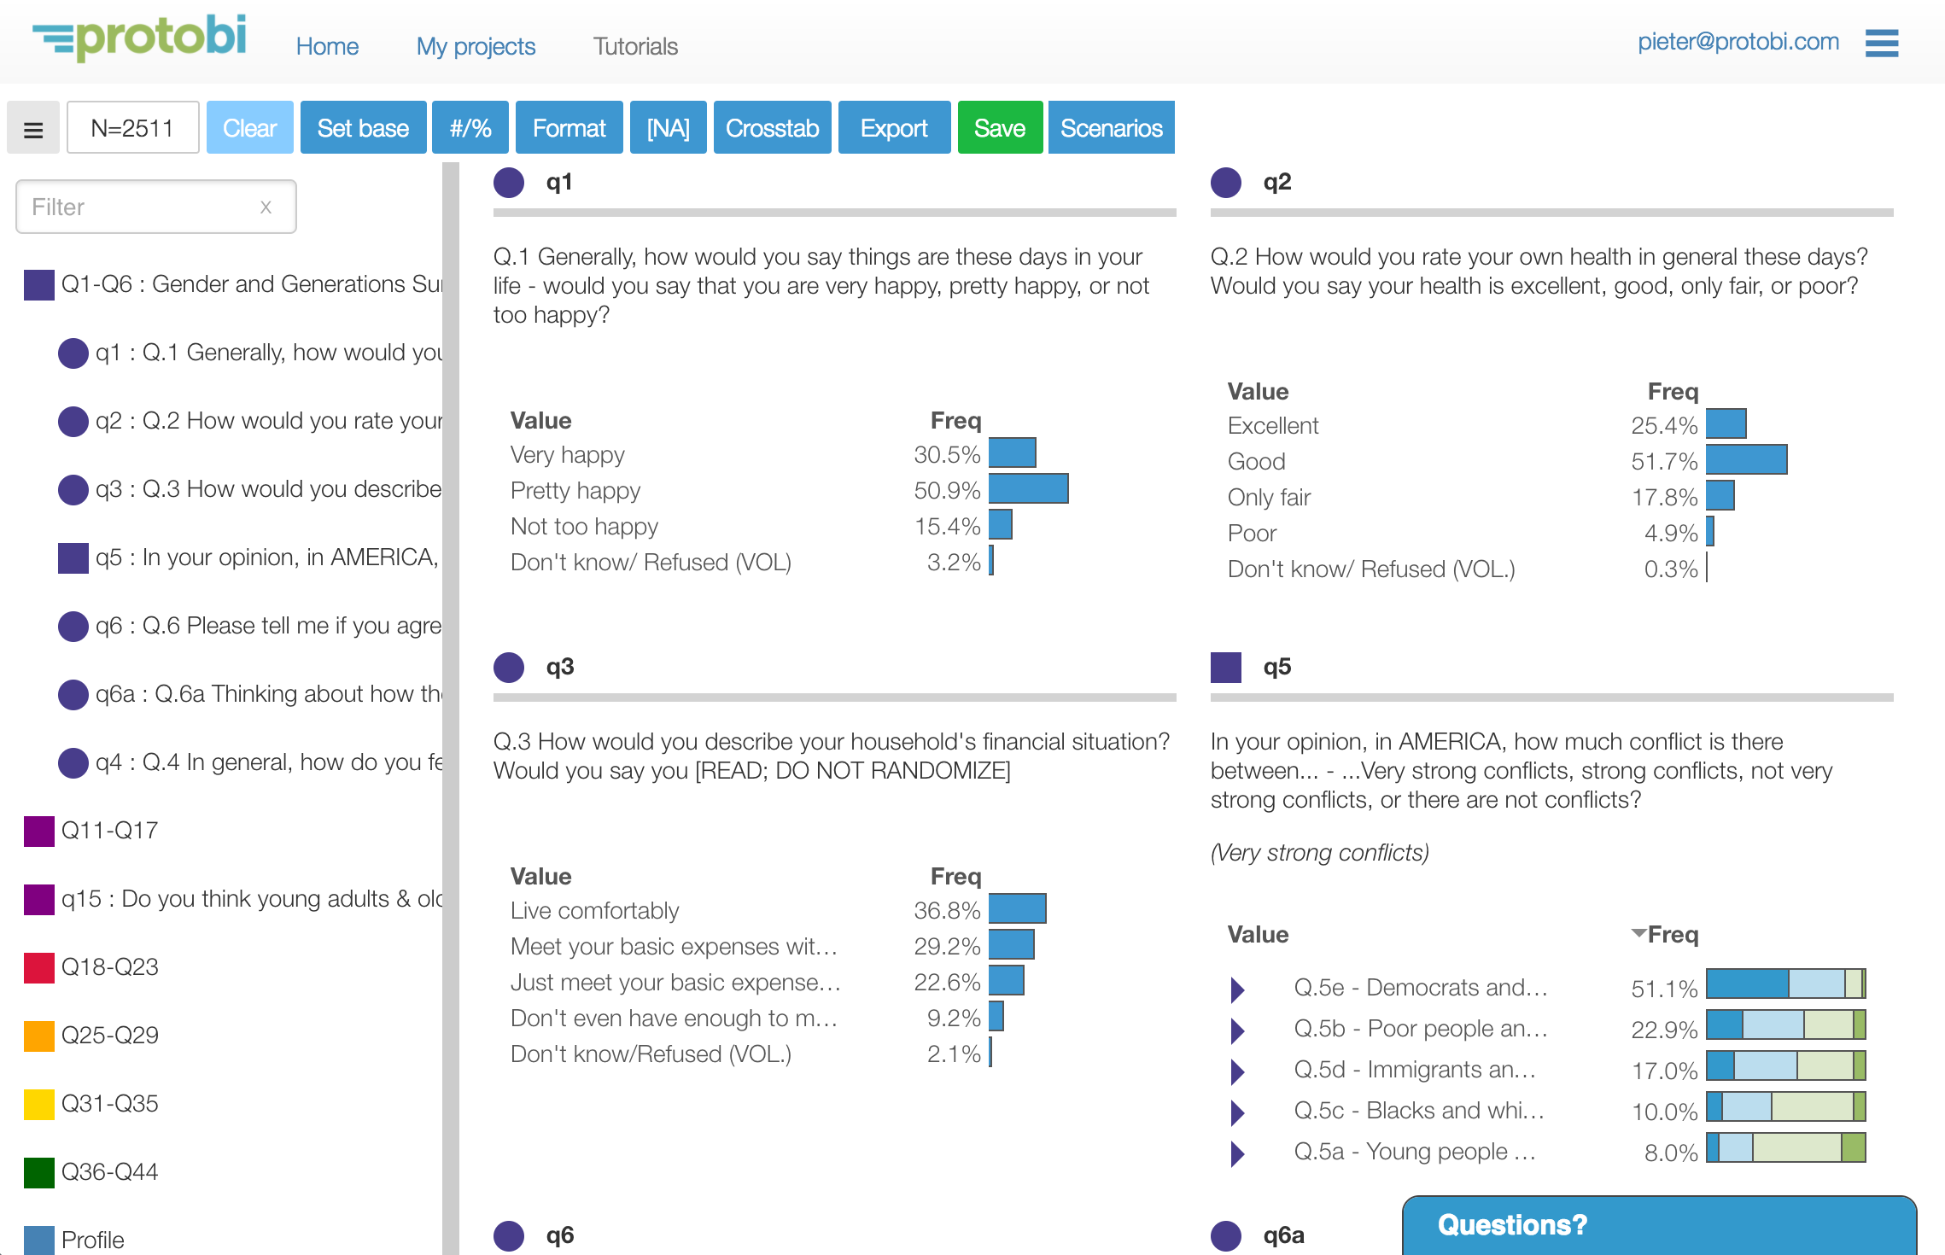
Protobi lets you see and explore all the data
Data presented graphically
Data organized conceptually

Slide 6
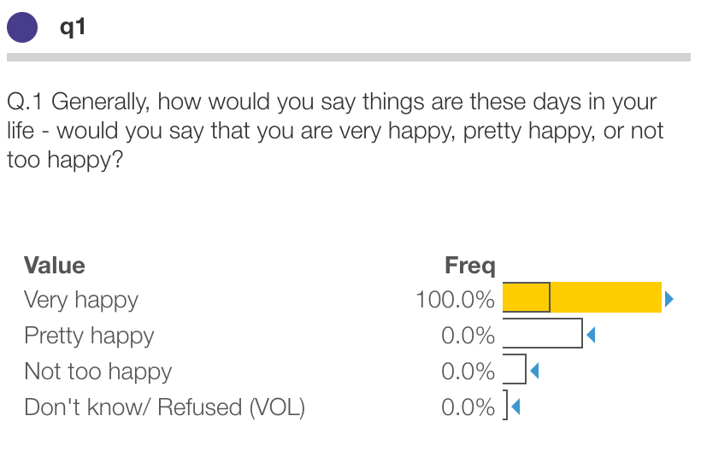
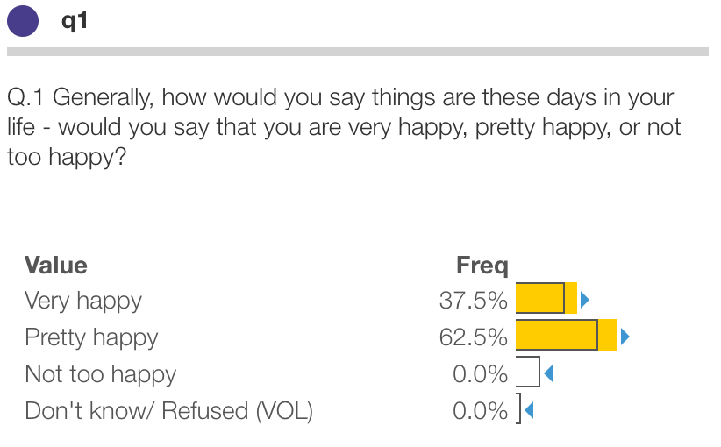
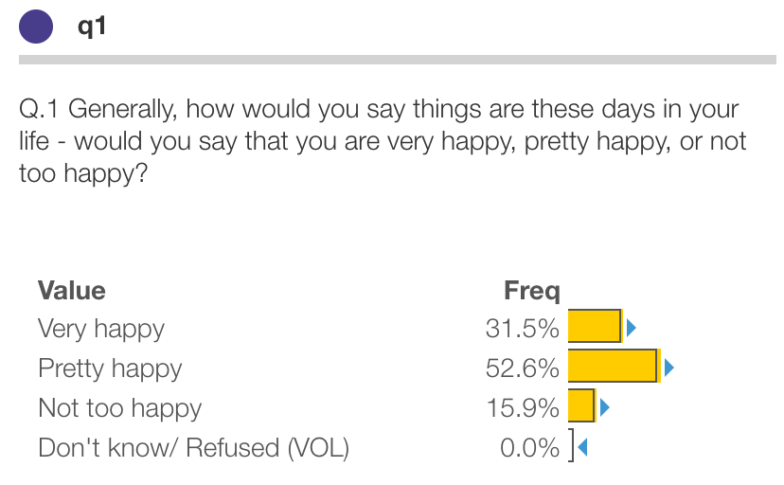
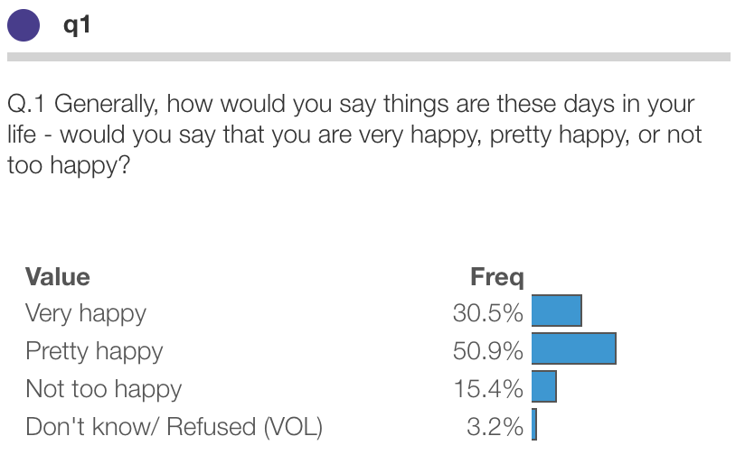
Click to simply express even complex queries
Click to filter on one value (“IS”)
Option/alt + click to filter multiple values (“OR”)
Click twice to clear filters
Shift-Click to exclude a value (“NOT”)

Slide 7
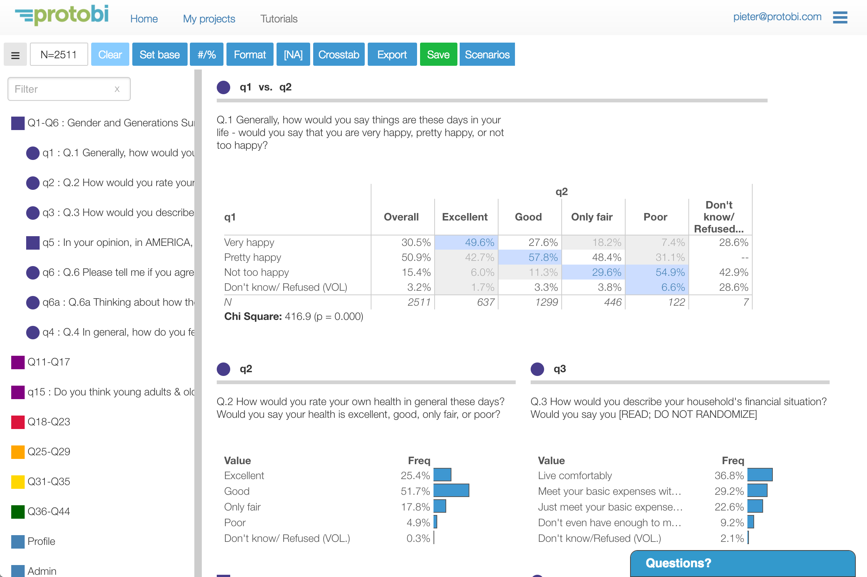
Instant crosstabs
Drag one element onto another for instant crosstabs

Slide 8
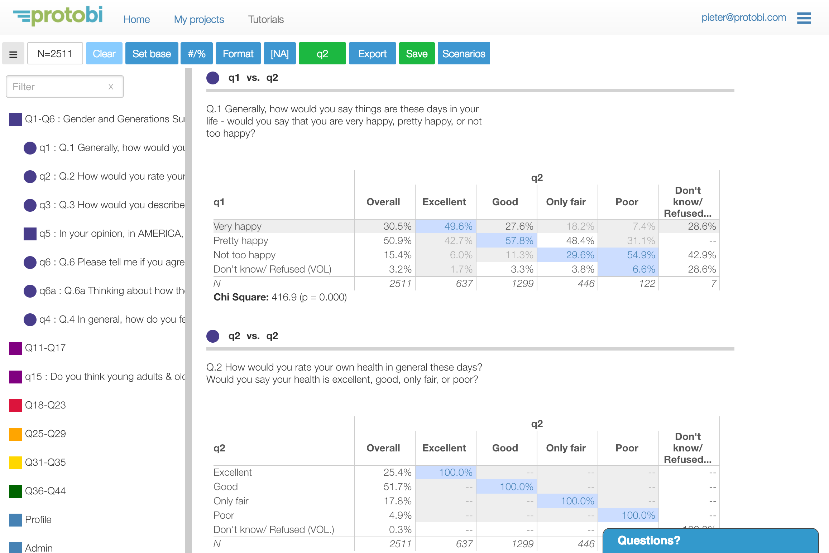
Global crosstabs
Drag an element to the Crosstab button for global crosstabs

Slide 9
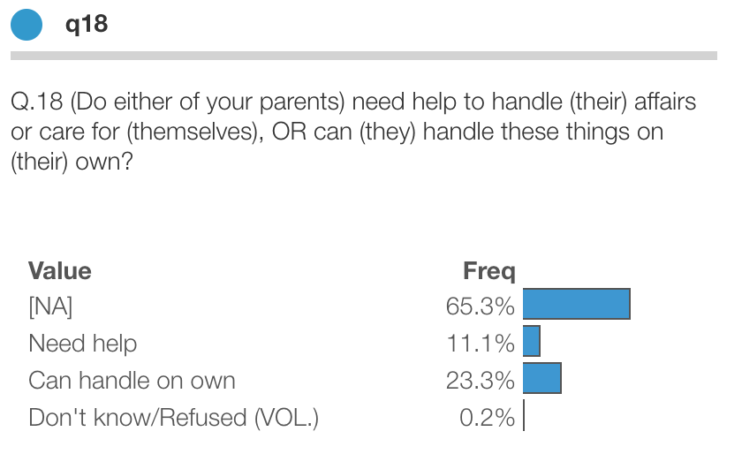
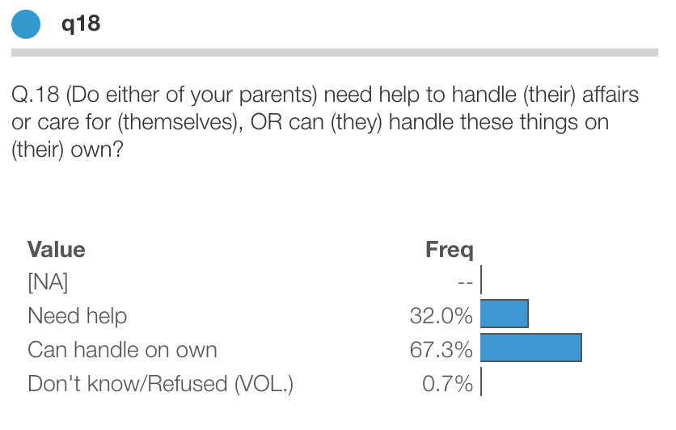
Toggle display of missing [NA] values
Percentages total 100% across all respondents
Percentages total 100% for those who answered this question

Slide 10
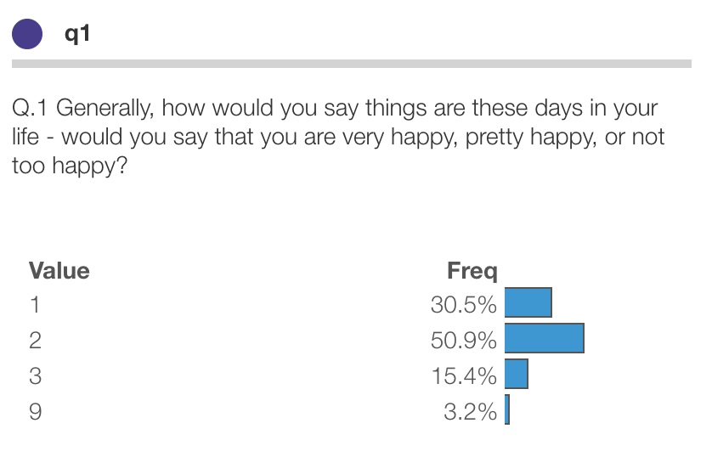
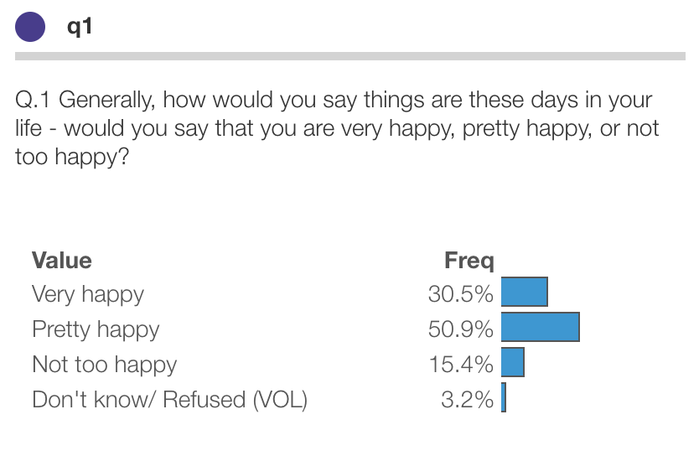
Toggle whether to show formatted or raw values
The actual data file has the raw values
Values formatted for display

Slide 11
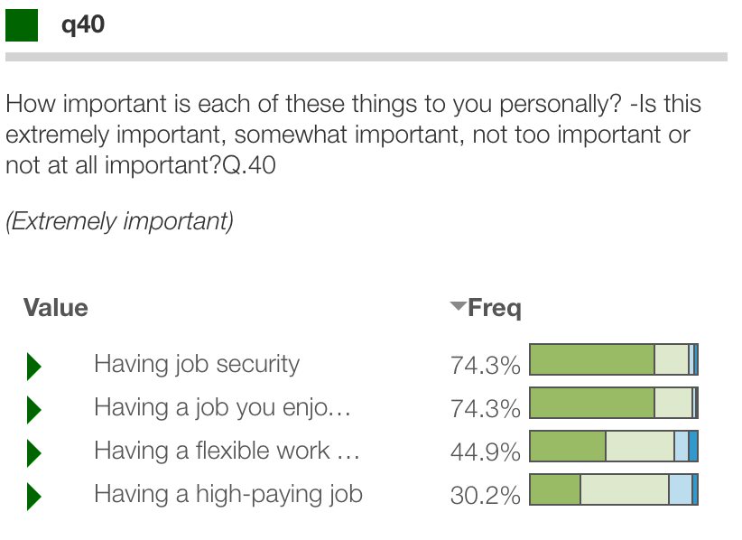
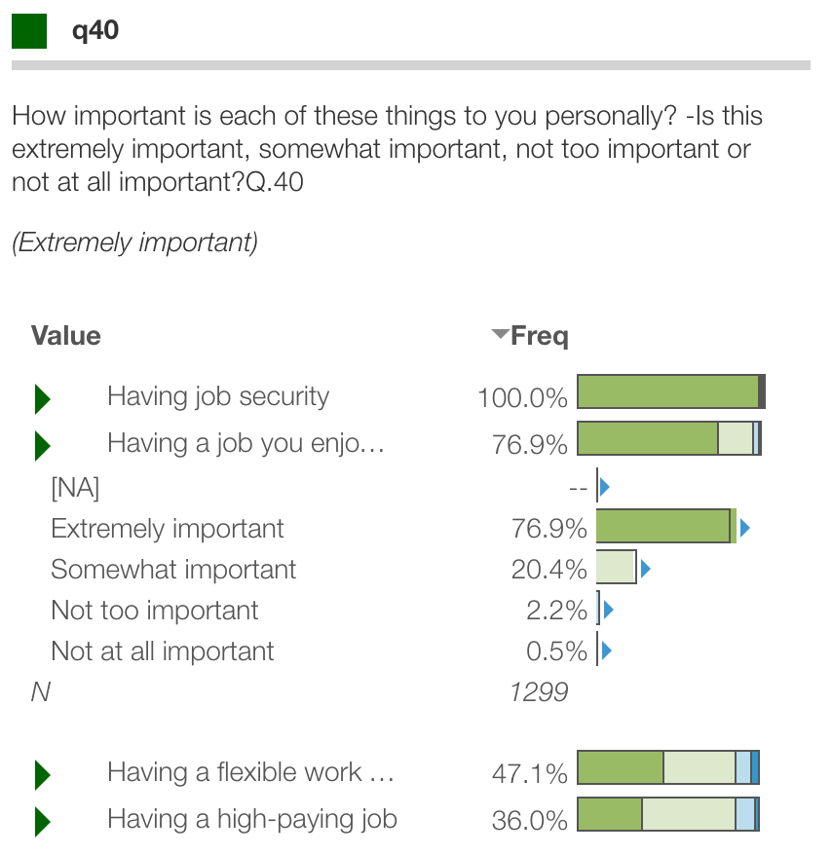
Compact/expand groups of related elements
Click triangles to see detailed distribution

Slide 12
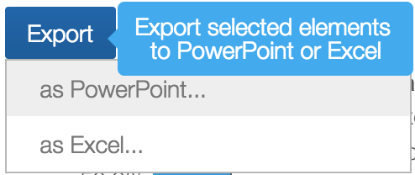
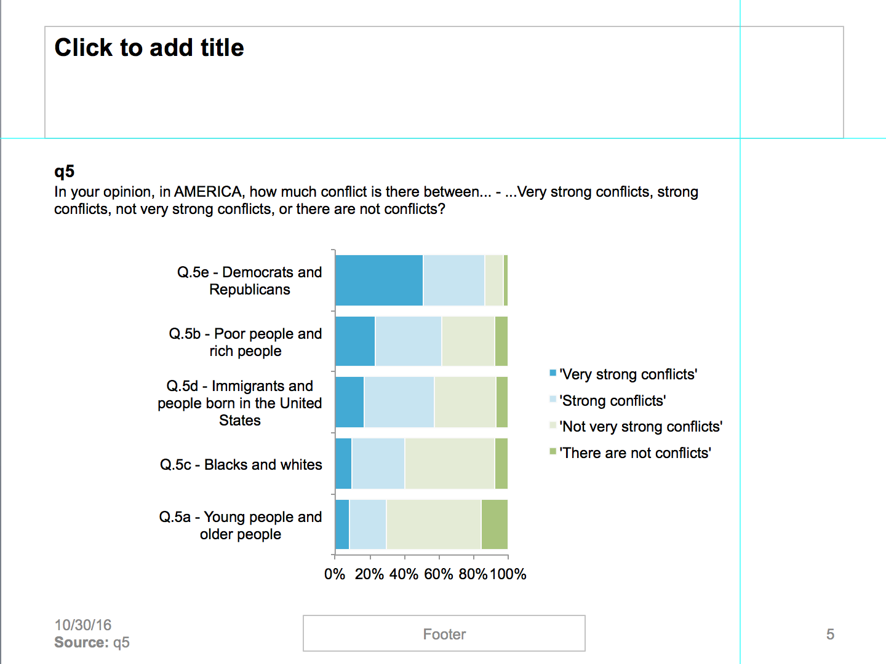
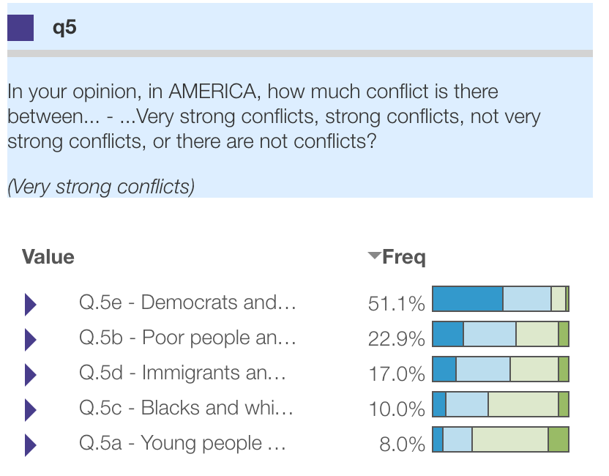
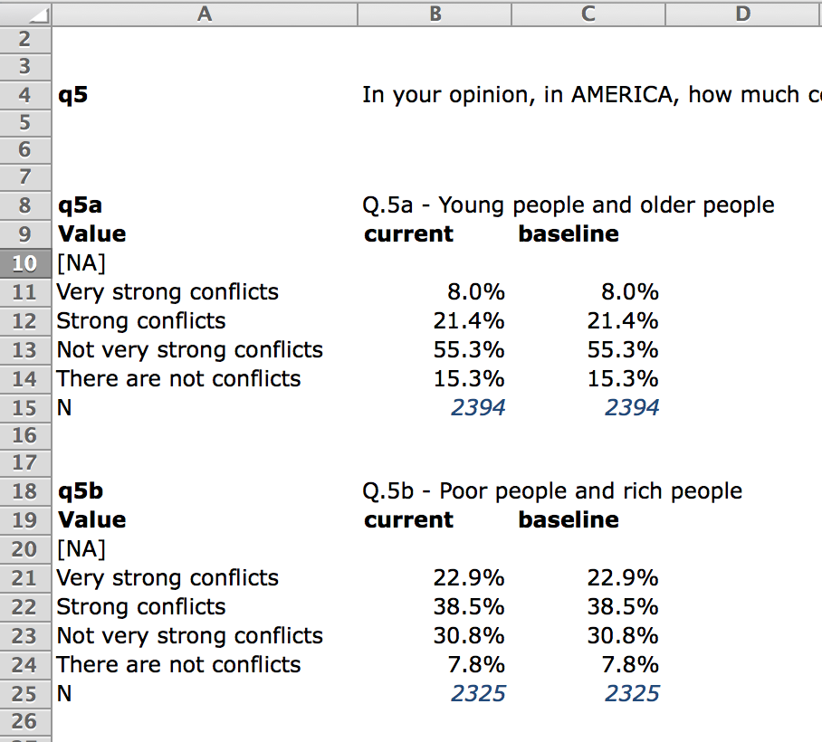
Export selected elements to Excel or PowerPoint
Native PowerPoint chart objects

Slide 13
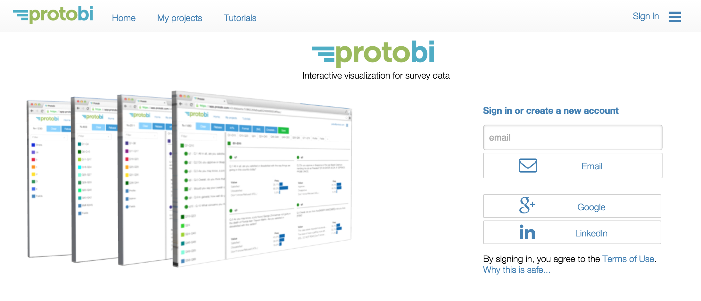
Sign in
Get a secure sign-in link by email
Or sign in OAuth

Slide 14
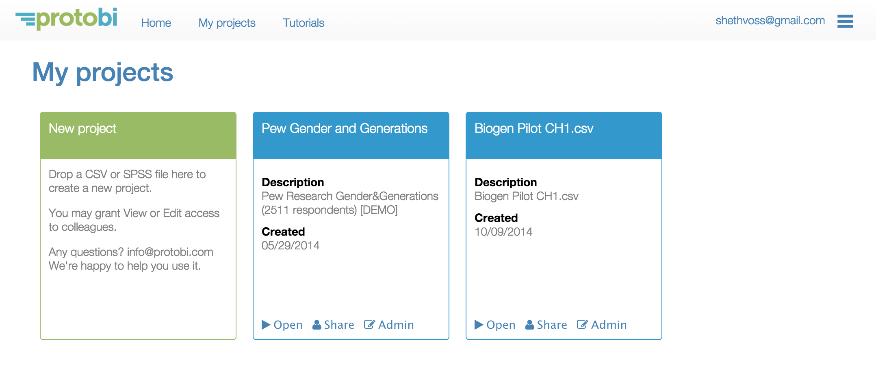
Open a project or create a new one

Slide 15
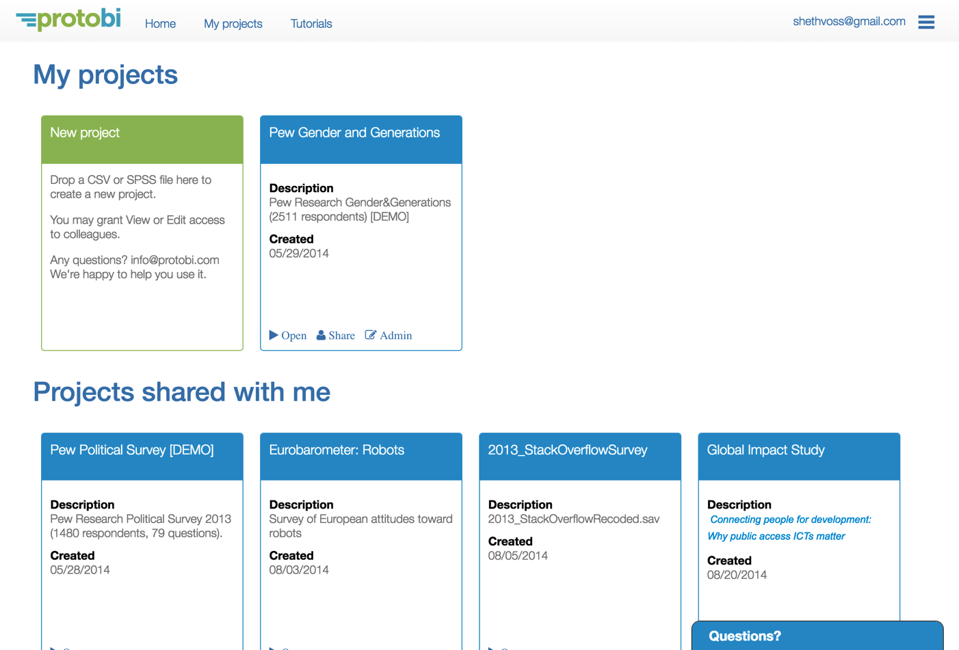
Neatly organize many survey projects
Share projects with colleagues and clients
Organized archive of current and past projects

Slide 16
Contact support
Contact support from within the app
Or email us at support@protobi.com

Slide 17
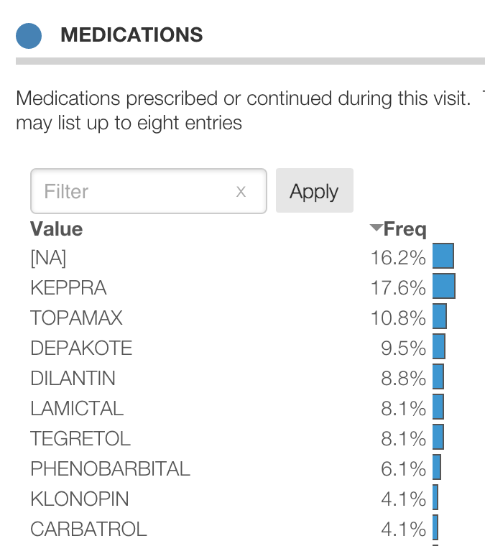
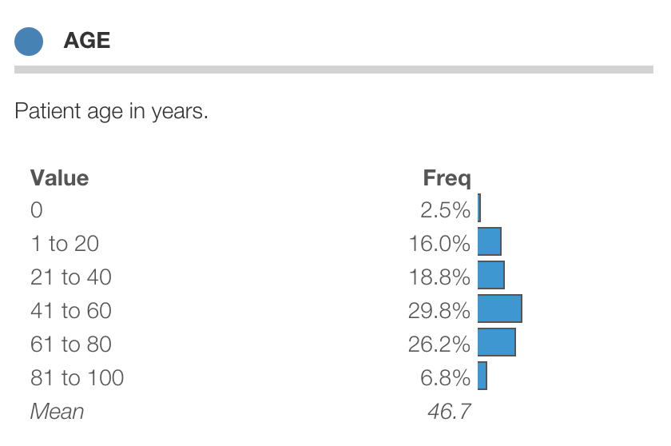
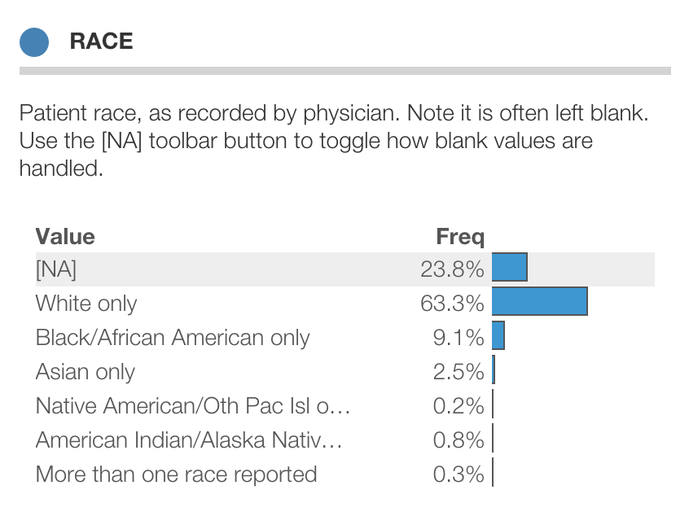
Protobi covers practical nuances
Coding (e.g. ICD-10, HCPCS)
Multiple response values
Long-tail distributions
Numeric ranges
Means
Calculations
Missing values
Variable and value labels
Percents, counts
Example data: CDC National Ambulatory Medical Care Survey, 2009

Slide 18
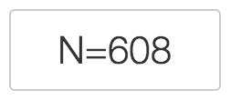
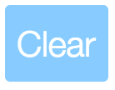
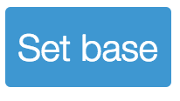
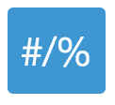
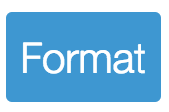
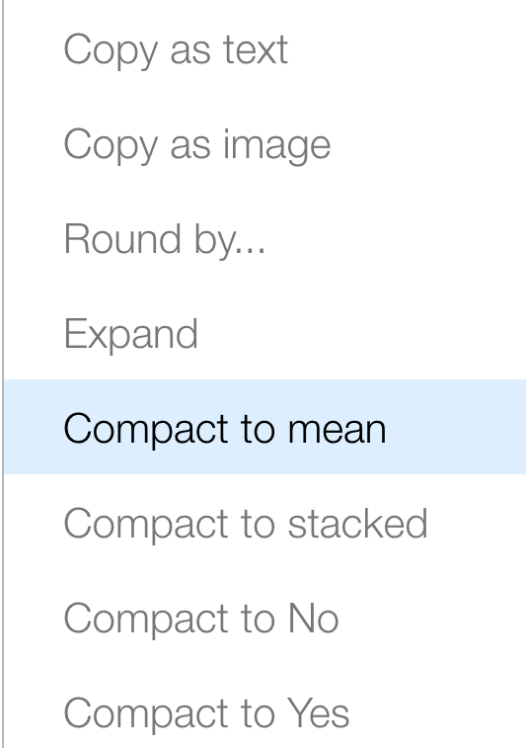
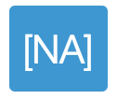
Protobi cheat sheet: Viewer
Toolbar
Clicks and drags
Current sample. Click to show filters.
Click “IS” … select one particular value as current filter
Shift+Click “NOT” … select not a value as current filter
Opt+Click “OR” … select multiple values as current filter
Drag An element onto another to create a crosstab
Shift+Drag An element onto another to nest crosstab banners
Clear all current filters
(e)
(b)
Set current filters as baseline for statistical comparisons.
(p)
Toggle whether to show frequencies as percentages or counts.
Edit menu
(f)
Toggle whether to display formatted or raw data values.
Select text you can copy to Excel.
(m)
Toggle whether blank/missing/NA values count toward percentages
Show image you can copy to PowerPoint.
Drag element here for global crosstabs
Set bin size: <number>, log, auto or none
Expand/collapse group of elements.
Export selected elements to Excel or PowerPoint
Show numeric group as mean values
Show rating scales as stacked bars
Show just bottom box score
Show just top box score

