Slide 1
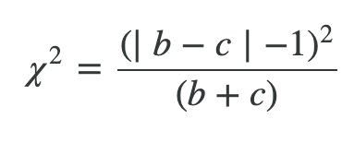
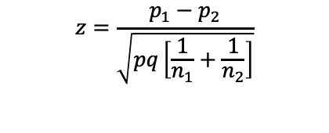
Comparing percentages:
Independent vs paired samples
Independent samples
Paired samples
When comparing different respondents in same survey (e.g. US vs EU) or different surveys (e.g. Wave 2 vs Wave 1) we typically use independent sample tests:
When comparing responses from the same respondents, we can use more precise “paired sample” tests that consider this additional information.
Protobi uses the standard Z test for independent samples
(and the Student t test for comparing independent means)
Protobi uses “McNemar’s test with Edward’s Correction for Continuity” for paired percentages (and the Paired t-test to compare means):
$$z=\frac{p_{1}−p_{2}}{\sqrt{pq\left[\frac{1}{n_{1}}+\frac{1}{n_{2}}\right]}}$$
where b is the count of discordant pairs in one direction,
and c the count of discordant pairs in the opposite direction.

Slide 2
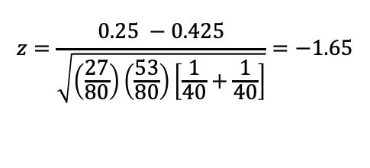
Example 1:
Independent samples
Sample A
Sample B
40 respondents
10 “Yes” answers
25% positive
40 respondents
17 “Yes” answers
42.5% positive
$$z=\frac{0.25 −0.425}{\sqrt{\left(\frac{27}{80}\right)\left(\frac{53}{80}\right)\left[\frac{1}{40}+\frac{1}{40}\right]}}=−1.65$$
p = 0.098 > 0.05
Difference is “Not significant”
p = 0.098 > 0.05
“Not significant”

Slide 3

Example 2:
Paired samples
Question A:
Question B:
40 respondents
10 “Yes” answers
25% positive
40 respondents
17 “Yes” answers
42.5% positive
$$z=\frac{{\left(\left|8−1\right|−1\right)}^{2}}{8+1}=4.0$$
1 switch “Yes” to “No”
8 switch “No” to “Yes”
p = 0.046 < 0.05
Difference is “Significant”
Out of 9 switches, 8 are from “No” to “Yes”.
Switches are significantly more likely to be from “No” to “Yes” than the other way.

Slide 4
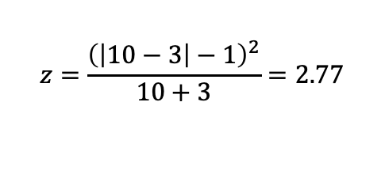
Example 3:
Paired samples
Question A:
Question B:
40 respondents
10 “Yes” answers
25% positive
40 respondents
17 “Yes” answers
42.5% positive
$$z=\frac{{\left(\left|10−3\right|−1\right)}^{2}}{10+3}=2.77$$
3 switch “Yes” to “No”
p = 0.098 > 0.05
Difference is “Not significant”
10 switch “No” to “Yes”
Out of 13 switches, 10 are from “No” to “Yes” versus 3 from “Yes” to “No”.
Here switches are not significantly more likely to be from “No” to “Yes” than the other way.

